Slide 1

Material passports and digital product passports in construction
Janneke Bosma jambosma@gmail.com Construction Management & Engineering

Slide 2
What is a material passport?
“A material passport (or product passport) is a digital interface composing a certified identity of a single identifiable product by accessing the set of life cycle registrations linked to this object in order to yield insight into the sustainability and circularity characteristics, the circular value estimation, and the circular opportunities for both that product and its underlying component and materials.” (van Capelleveen et al., 2023)

Slide 3
What is a material passport?
Digital interface;
Single identifiable product and associated life cycle information ;
Gaining insight into sustainable and circular characteristics, value, and opportunities;
Not only of the product, but also underlying components and materials.

Slide 4
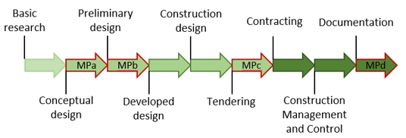
When can you use a material passport?
Notes:
Mpa - serves as a rough estimation and optimization tool. Variants studies can look at the most appropriate construction based on recycling potential and environmental impact. This phase has the most impact in terms of recycling, waste and environmental impact. When using BIM, it is important here that the geometry is properly modulated and the elements are assigned the correct classification.
MPb - also functions as an optimization tool. Here e.g. thicknesses and layers of the applied product/material can still be adjusted.
MPc - During the tender phase, the exact material composition can be checked.
MPd- Serves as documentation in which the final situation is recorded and this can serve as a second-hand raw materials register.

Slide 5

Challenges
Unclear exactly what belongs in a passport (no format);
The purpose of the passport differs, creating confusion among stakeholders about the benefits of a passport;
The above also creates limitations in creating (semantic and technical) standards to implement;
There is a lack of Environmental Product Declarations and reliable inputs;

Slide 6
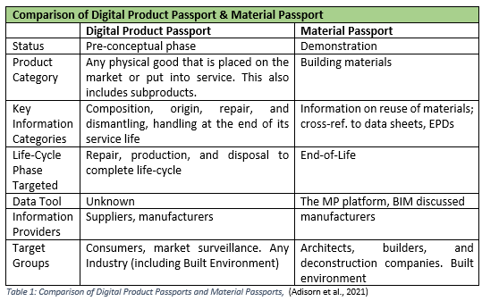
From material passport to digital product passport
In the literature, the terminology of an MP and DPP is used interchangeably;
DPP is seen as a solution to the lack of consistent and trustworthy information;
It can serve as a track and trace tool;
Expected to become ‘Mandatory’ in 2026

Slide 7
Content of a digital product passport
Currently no format;
General components content: production data, usage data, end-of-life data and life cycle data;
‘Must haves’ defined;
See next slide for the must haves.

Slide 8
Content of a digital product passport
Missing topics from the workshop
Environmental Product Declaration;
General info (coordinates, object number, etc);
Data on maturity (maturity measurements);
Strategically scarce materials;
Inspections during the construction phase;
Information about the environment (e.g. subsoil)
Information on weather conditions during execution.

Slide 9
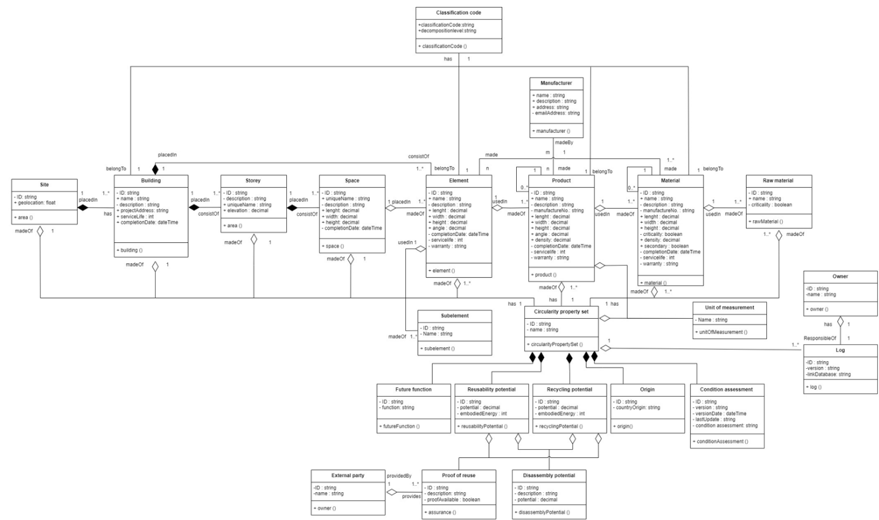
Content of a digital product passport – Data structure
Notes:
See github / thesis for image

Slide 10
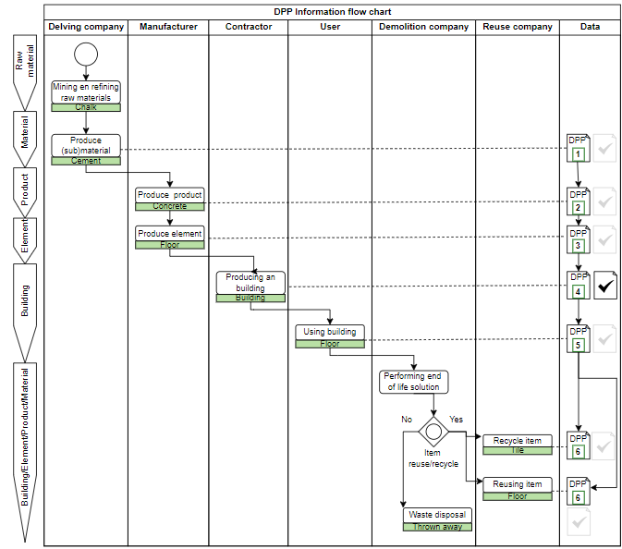
Process DPP
Notes:
On the right is the see that in every phase before handing over information a validation (check) should take place. Within the thesis the focus is on contractor level.

Slide 11
MP/DPP Selectie
Existing material passports/digital product passports compared based on must haves (applicability) and general requirements.
For general requirements, see the footnote below this slide.
Explanation behind the score can be found in the thesis.
Notes:
General requirements DPP:
Legal obligations: It need to be ensured the DPP will be compliant with the General Data Protection Regulation (GDPR) (Berg et al., 2022)(Jansen et al., 2023) , the Extended Producer Responsibility (EPR), the EU government legislation “right to repair”, and the new Ecodesign for Sustainable Products Regulation (ESPR) (Jansen et al., 2023).
Functional suitability: Alignment with sector-specific needs is essential, particularly for supporting circular economy objectives and ensuring supply chain transparency. The MP should not impede existing chain processes, product quality, or safety (Jansen et al., 2023).
Security, confidentiality, and IP protection: The data must guarantee origin, integrity, verifiable, and compliance. Immutability is essential and secure data exchange within the value chain members must be ensured. The data control should remain with the data providers to safeguard intellectual property (Jansen et al., 2023) (Buchholz & Lützkendorf, 2022).
Accessibility: Ensure access for assigned parties through an access control mechanism. Furthermore, ensuring participation opportunities for the parties without stable internet connections or advanced IT systems (Jansen et al., 2023). According to (Buchholz & Lützkendorf, 2022) the user needs permanent access to the whole life cycle data. Furthermore, the data should be easy understandable for the user.
Interoperability: The MP information must be exchangeable across different company boundaries. This interoperability within and between systems will be enabled by the use of shared semantics and standardized data schemes (Jansen et al., 2023) (Buchholz & Lützkendorf, 2022).
Modularity and Modifiability: The MP should offer flexibility, allowing users to make additions and modification. Furthermore, actors, products, or attributes can be removed or adapted as requirements evolve, making it essential for the MP to accommodate the changes in the value chain (Jansen et al., 2023).
Availability and Time behavior: The information should be accessible when needed, with changeable requirements for real-time data in various use cases. Certain parts may need to be real-time capable (Jansen et al., 2023). The data always needs to be valid and up to date (Buchholz & Lützkendorf, 2022).
Portability: The information should be transferable between software systems to enable decentralized systems. Portable product identifiers are needed to track a products’ life cycle. In addition, they should be harmonizable and referenceable across the EU (Jansen et al., 2023). According to (Buchholz & Lützkendorf, 2022), a chronological timeline of the evolution needs to exist by tracing back the data. Each passport should contain a unique identifier which is linked to the information about the basic characteristics (European Commission, 2020a).
Non-Redundancy: At the passport level the data should not contain excessive information (Buchholz & Lützkendorf, 2022).

Slide 12
Regelgeving en definities
Regulations that (potentially) affect a dpp:NEN 2767 & NEN 2660
ISO 15926 & open standard CB-NL
CSRD & ESRS E5 (gebruik termonoloy)
EU Taxonomy (?)
Differences definitions:
There are different opinions about what is defined as product/material, etc.
This also counts for recycle and reuse (I have used definition CSRD & ESRS E5)
Notes:
Regarding the definition for material and product. during my research I used this one from circular building cb'23. However, this differs with e.g. different existing data structures. It is therefore important to be clear before reporting which level is used for what.

